Slide 1
Prediction of Credit Risk
Using Lending Data for Predictive Analysis
Rajendra Gudimetla
Sriman Paluri,
Sai Vignesh Singam,
Prediction of Credit Risk

Slide 2
Introduction
Objective: Predict loan status (credit risk) using machine learning.
Dataset: lending_data.csv (77,536 rows, 8 columns). Models: Logistic Regression, Random Forest, SVM.
Goal: Compare model performance and identify the best predictor.
Prediction of Credit Risk

Slide 3
Dataset Overview
Source: lending_data.csv
Features: loan_size, interest_rate, borrower_income, debt_to_income, num_of_accounts, derogatory_marks, total_debt, loan_to_income_ratio (derived).
Target: loan_status (0 = low risk, 1 = high risk). No missing values detected.
Prediction of Credit Risk

Slide 4
Data Preprocessing: Feature Engineering
Added feature: loan_to_income_ratio = loan_size / borrower_income.
Helps capture the relationship between loan size and income.
Formula:
loan_to_income_ratio = ^{loan_size}
borrower_income
Prediction of Credit Risk

Slide 5
Data Preprocessing: Splitting and Scaling
Split data: 70% training, 30% testing (stratified by loan_status).
Random state: 42 for reproducibility.
Scaled features using StandardScaler to normalize data.
Ensures better model performance for distance-based algorithms (e.g., SVM).
Prediction of Credit Risk

Slide 6
Modeling Approach
Models used:
Logistic Regression (baseline). Random Forest (ensemble method).
Support Vector Machine (SVM, linear kernel).
All models trained with random_state=42. Focus: Predict loan_status (binary classification).
Prediction of Credit Risk

Slide 7
Evaluation Metrics
Metrics calculated:
Accuracy: Overall correctness. Precision: Positive predictive value. Recall: Sensitivity to high-risk loans.
ROC-AUC: Model discrimination ability.
5-fold Cross-Validation ROC-AUC: Generalization.
Visualized using ROC curves.
Prediction of Credit Risk

Slide 8
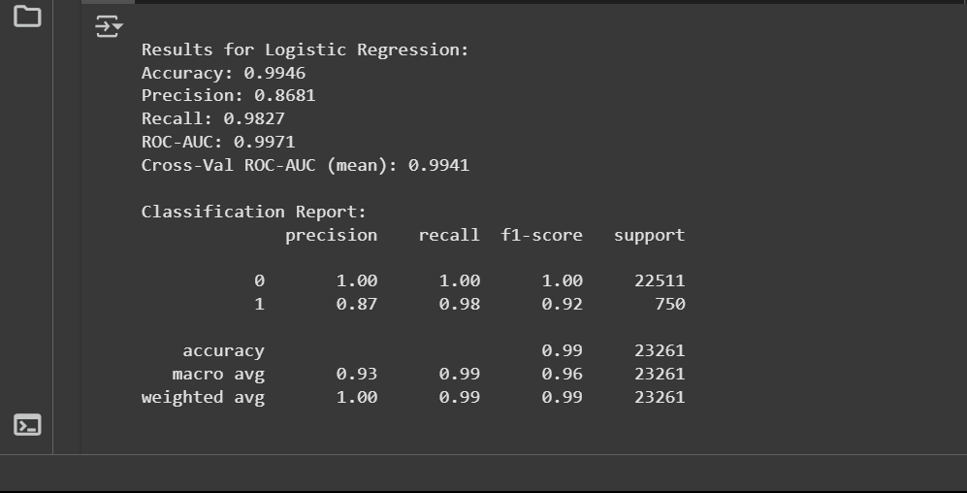
Model Performance: Logistic Regression
Accuracy: 0.9946
Precision: 0.8681
Recall: 0.9827
ROC-AUC: 0.9971
Cross-Val ROC-AUC: 0.9941
High recall, excellent for identifying high-risk loans.
Prediction of Credit Risk

Slide 9
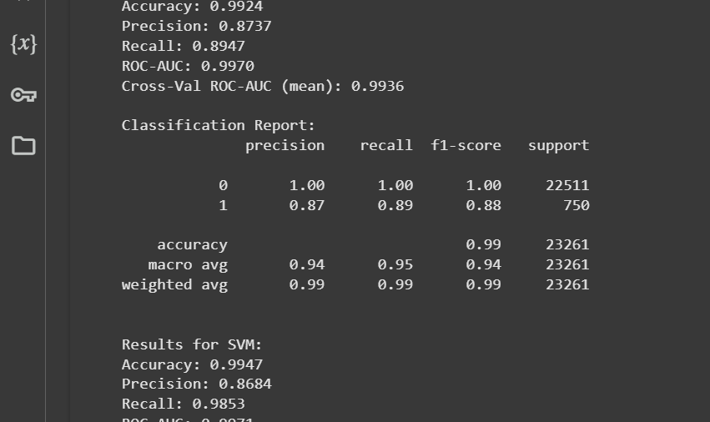
Model Performance: Random Forest
Accuracy: 0.9924
Precision: 0.8737
Recall: 0.8947
ROC-AUC: 0.9970
Cross-Val ROC-AUC: 0.9936
Balanced precision and recall, slightly lower recall than Logistic Regression.
Prediction of Credit Risk

Slide 10
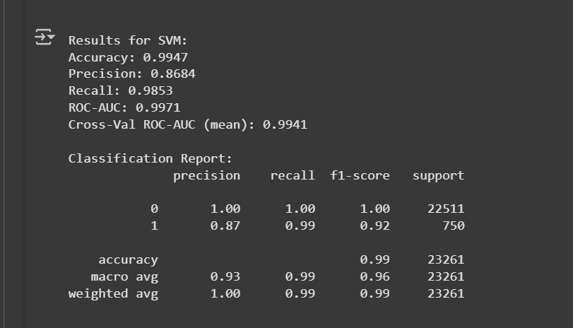
Model Performance: SVM
Accuracy: 0.9947
Precision: 0.8684
Recall: 0.9853
ROC-AUC: 0.9971
Cross-Val ROC-AUC: 0.9941
Best recall, slightly better than Logistic Regression.
Prediction of Credit Risk

Slide 11
Model Comparison Summary
Model | Accuracy | Precision | Recall | ROC-AUC C
Logistic Regression | 0.9946 | 0.8681 | 0.9827 | 0.9971
Random Forest | 0.9924 | 0.8737 | 0.8947 | 0.9970
SVM | 0.9947 | 0.8684 | 0.9853 | 0.9971
Table: Model Performance Metrics
Prediction of Credit Risk

Slide 12
Visualization: ROC Curves
ROC Curves plotted for all models.
All models show high AUC ( 0.997), indicating strong discrimination.
Placeholder: Include roc_curves.png (generated in notebook).
Prediction of Credit Risk

Slide 13
Visualization: Correlation Heatmap
Correlation heatmap of features.
High correlations: interest_rate, borrower_income, total_debt, debt_to_income.
Placeholder: Include correlation_heatmap.png (generated in notebook).
Prediction of Credit Risk

Slide 14
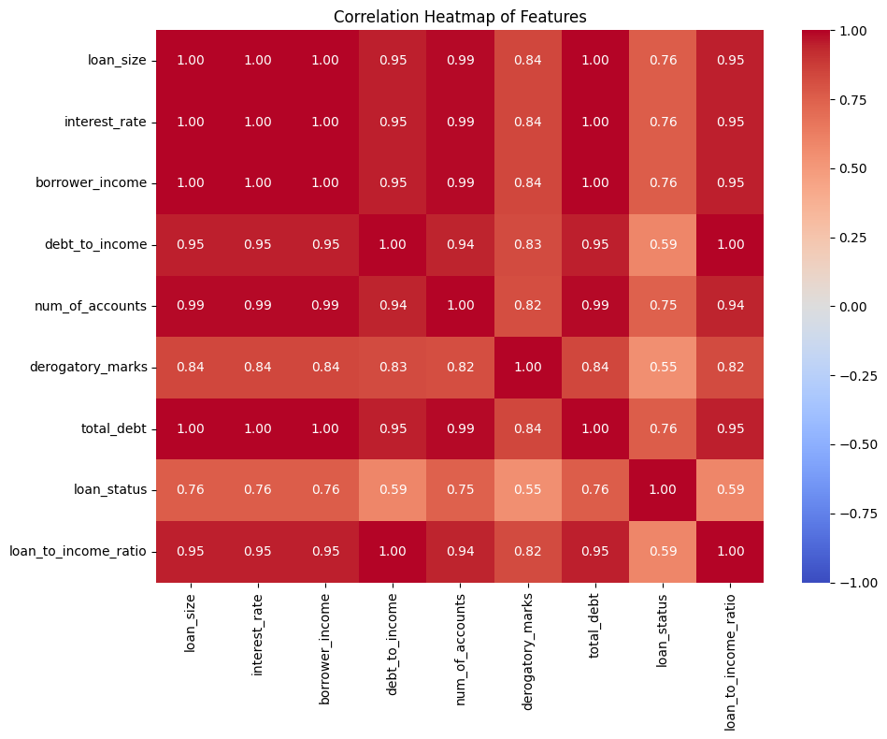

Slide 15
Feature Importance (Random Forest)
Top features:
interest_rate: 0.2595
borrower_income: 0.2185
debt_to_income: 0.1401
Least important: derogatory_marks (0.0001).
Insight: Interest rate and income are key predictors of loan status.
Prediction of Credit Risk

Slide 16
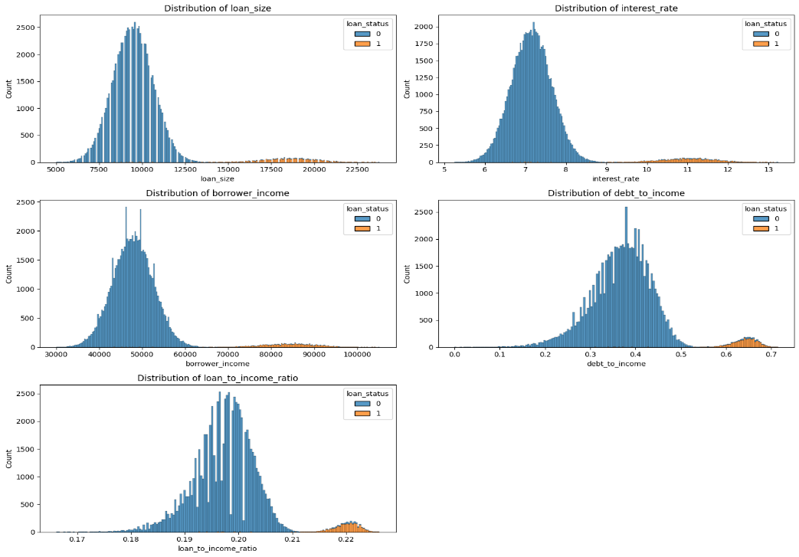

Slide 17
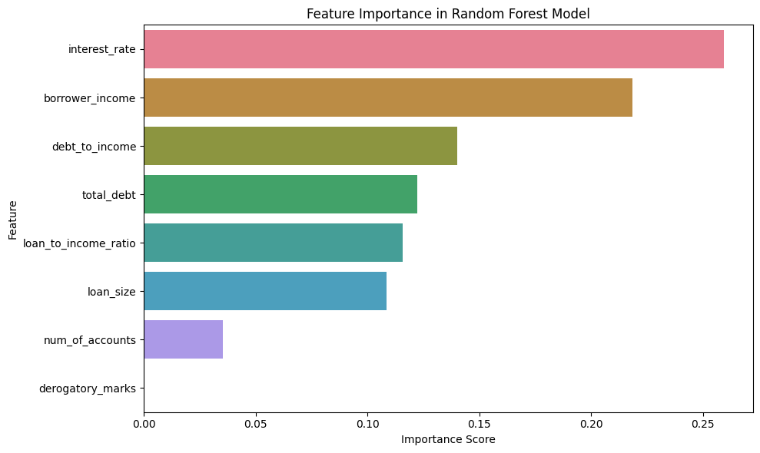

Slide 18
Conclusion
Best Model: Logistic Regression (ROC-AUC: 0.9971). Saved as best_credit_risk_model.pkl with scaler.pkl.
Key Insight: High recall ensures most high-risk loans are identified.
Prediction of Credit Risk

